Slide 1
Chapter 1
Enterprise Engineering
Ronald E. Giachetti, Ph.D.
Associate Professor
Industrial and Systems Engineering, FIU

Slide 2
Overview
Define enterprise engineering
Describe types of enterprises
Describe the enterprise design methodology
Describe the intellectual developed that have contributed to modern thought on enterprise engineering
Describe the requisite knowledge and skills for enterprise engineering
Describe the dynamic environment enterprise operate in
Ronald E. Giachetti
November 8, 2026
Slide <number>

Slide 3
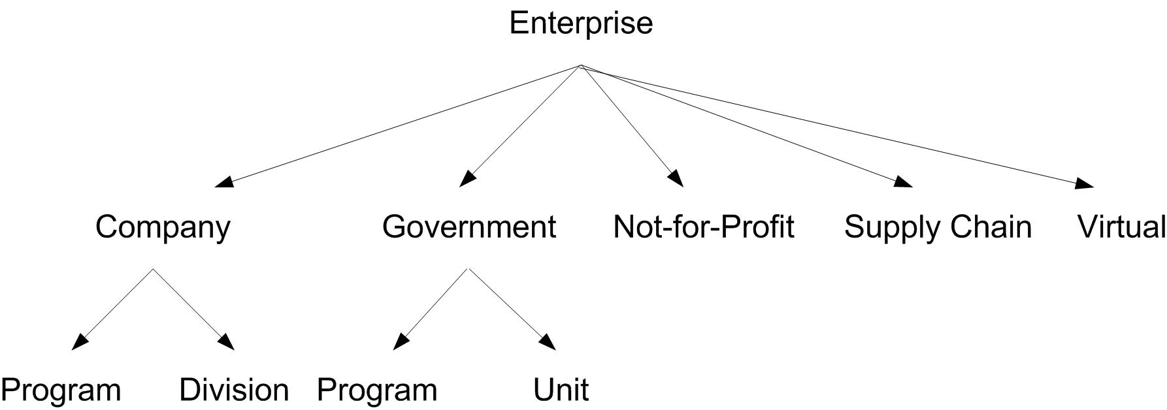
Enterprise Systems
We use the term ‘enterprise’ because is encompasses all types of enterprises; moreover, we later use the term organization to discuss a single view of the enterprise
Ronald E. Giachetti
November 8, 2026
Slide <number>

Slide 4

Enterprise Definition
An enterprise is a complex, socio-technical system that comprises interdependent resources of people, information, and technology that must interact with each other and their environment in support of a common mission.
  Interactions important to behavior - include such activities as coordination of functions, sharing of information, and allocation of resources.
  socio-technical system - it involves people and technology.
  open system - it interacts with its environment.
  purposeful - it has goals that it works towards accomplishing.
Ronald E. Giachetti
November 8, 2026
Slide <number>

Slide 5
Common Characteristics
All enterprises are systems, where a system is an integrated collection of components (people and technology).
All enterprises use resources, an important resource class is the people employed by the enterprise.
All enterprises produce a product, provide a service, or do both.
All enterprises have customers who receive the benefits of the product or service.
Ronald E. Giachetti
November 8, 2026
Slide <number>

Slide 6
Enterprise Engineering
The body of knowledge, principles, and practices to design an enterprise
Enterprises are not designed just once – they are continuously being designed
Ronald E. Giachetti
November 8, 2026
Slide <number>

Slide 7
How Enterprise are designed
Enterprises have existed for millennium
To a large extent the enterprise was not viewed as a whole system that could be designed
Ad hoc, short-term, local design
Ernst & Young study found that many companies have processes that were designed long before the advent of IT
Ronald E. Giachetti
November 8, 2026
Slide <number>

Slide 8
Enterprise Engineer
Business Systems Analyst (Business Analyst, System Analyst, and Process Analyst)
Enterprise Architect
System Architect
Project Manager
System Designer
Change Manager
System Engineer
Application Developer (web application developer, Java developer, ERP developer, etc.)
Ronald E. Giachetti
November 8, 2026
Slide <number>

Slide 9
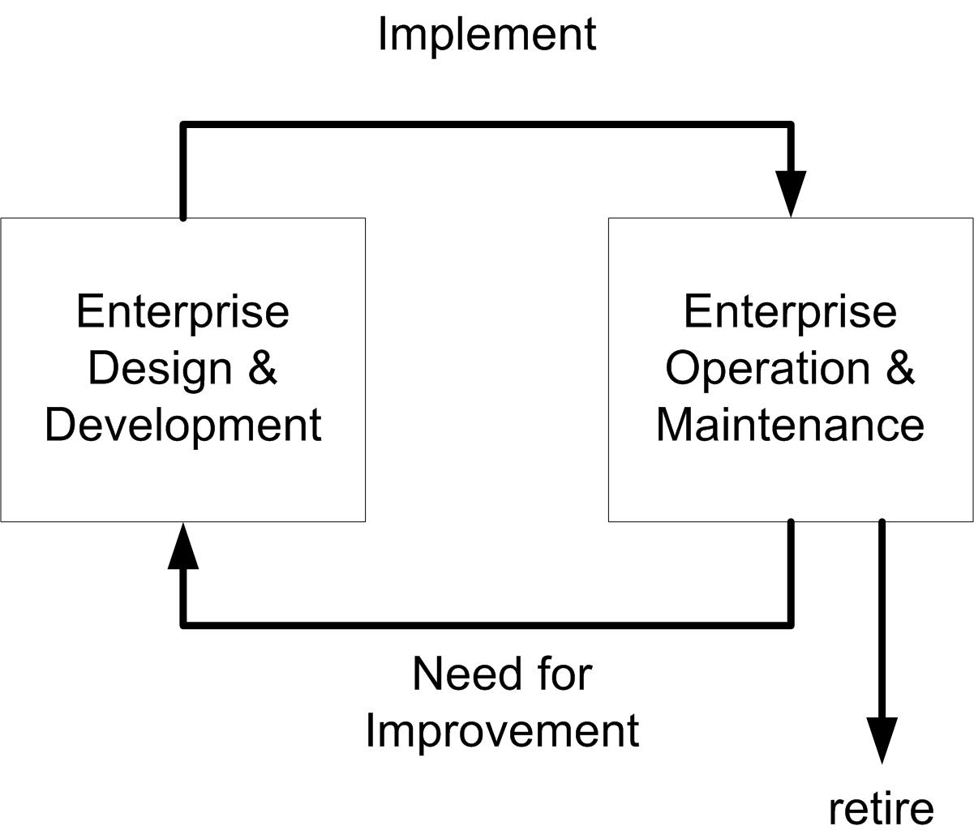
Enterprise Life-cycle
System identification – The system boundaries, purpose, and project scope are defined. The system strategy is identified.
Analysis – The system problems are analyzed, requirements are generated.
Design – The system design is generated.
Construction – The system is built.
Implementation – The system is implemented and deployed into its environment.
Operation and Maintenance – The system is operated and maintained.
Decommission – The system is retired.
Ronald E. Giachetti
November 8, 2026
Slide <number>

Slide 10

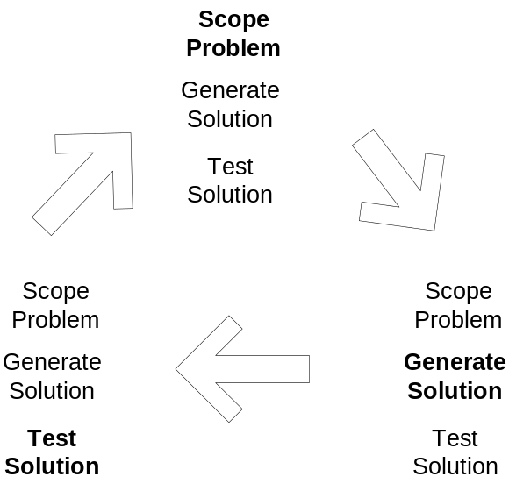

Enterprise Design Method
Problem Solving consists of three activities
  Scope Problem
  Generate Solution
  Test Solution
Not necessarily iterative; as you scope you’re thinking about solutions, etc.
Related to Plan, Do, Check, Act.
Ronald E. Giachetti
November 8, 2026
Slide <number>

Slide 11
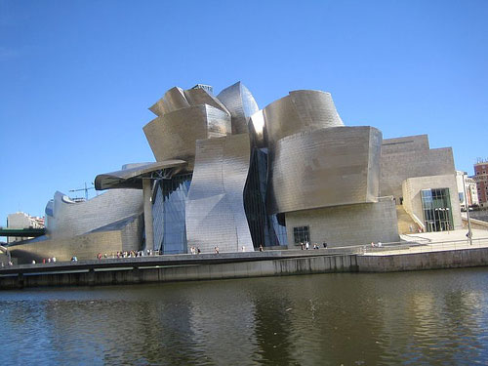
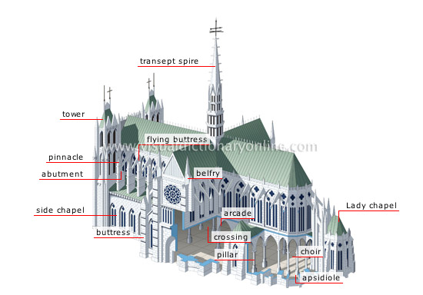
Enterprise Architecture
An architecture provides a holistic design of the enterprise with which all enterprise projects must conform
Guarantee’s design consistency towards the enterprise goals
Ronald E. Giachetti
November 8, 2026
Slide <number>

Slide 12
Enterprise Engineering Projects
Strategy-initiated Project
Subsystem Design
Reengineering or other large-scale transformation projects
Enterprise Information System
Continuous improvement
Supply chain project
Ronald E. Giachetti
November 8, 2026
Slide <number>

Slide 13
Enterprise Environment
Understanding the rapidly changing environment enterprises operate in
Ronald E. Giachetti, Ph.D.
Associate Professor
Industrial and Systems Engineering, FIU

Slide 14

Enterprise Environment
Enterprises are open systems, which means they interact with their environment
  Must understand enterprise in the context of its environment
Competitive, dynamic, and global environmental
Ronald E. Giachetti
November 8, 2026
Slide <number>

Slide 15
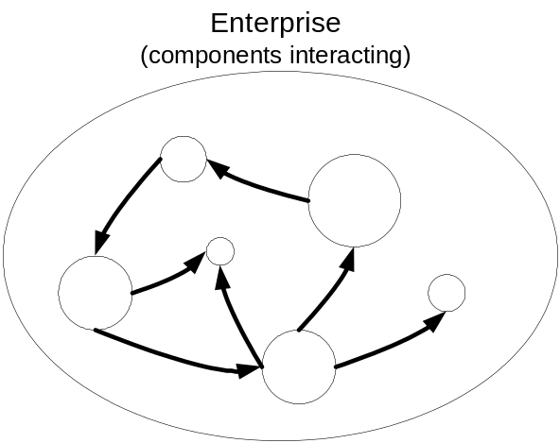
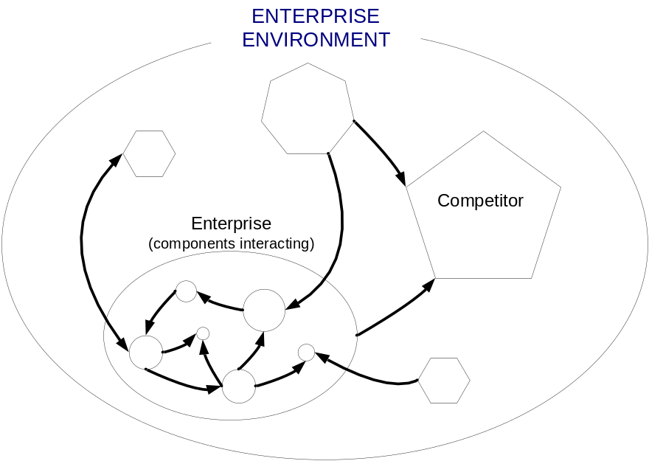
Closed versus Open Perspective
Too often we think about, analyze, and design enterprises as if they stand alone
When in fact, we need to consider the external environment (labor, capital, competitors, regulatory, natural)
Ronald E. Giachetti
November 8, 2026
Slide <number>

Slide 16
Trends towards Globalization
trends are:
  Fast, easy movement of people, knowledge, and technology
  Cheap, ubiquitous telecommunications, mobile devices, and pervasive computing
  Global competition
  Demanding customers requiring competition on price, quality, features/performance, and speed
  Increasing cost of natural resources and their greater scarcity
Ronald E. Giachetti
November 8, 2026
Slide <number>

Slide 17

Globalization
The removal of barriers to the world-wide flow of materials, information, people, and knowledge
Products & Services are no longer confined by geography or culture
Ronald E. Giachetti
November 8, 2026
Slide <number>

Slide 18
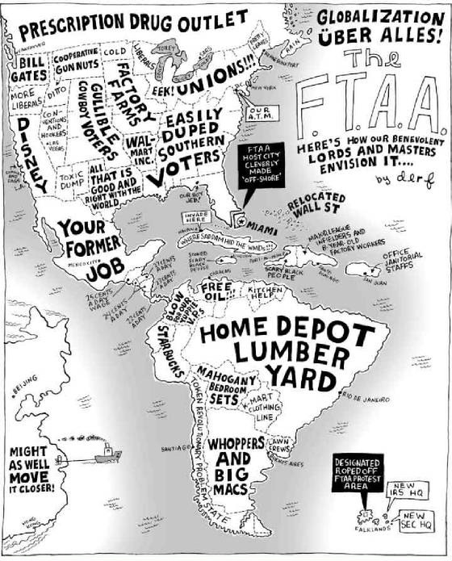
Notes:
This is a political cartoon that appeared in the US newspapers when the FTAA met in Miami, FL. It satirizes the stereotypes of global trade.

Slide 19
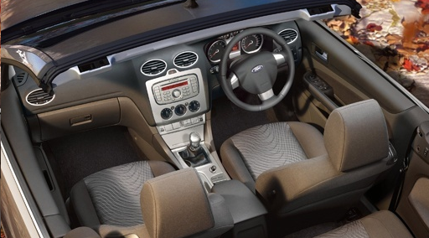
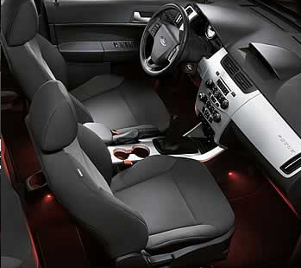
Globalization Affects Design
Ford in UK
Ford in US
Ronald E. Giachetti
November 8, 2026
Slide <number>
Notes:
Design of left-handed versus right-handed car by Ford.

Slide 20
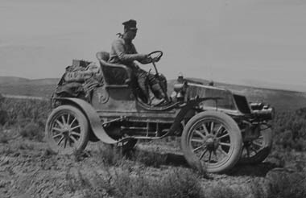
Fast, Easy Movement of People
First cross-country trip made by auto was in 1903 by Dr. Horatio Nelson Jackson – 63 days and $8,000.
  No gas stations in 1903
  Only 150 miles of paved roads
Dr. Nelson driving cross country in 1903.
Ronald E. Giachetti
November 8, 2026
Slide <number>

Slide 21
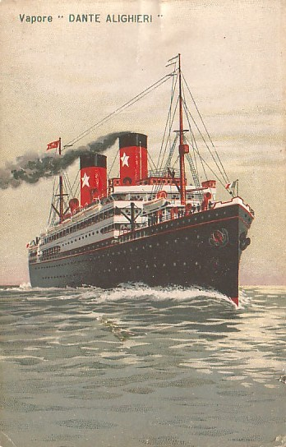
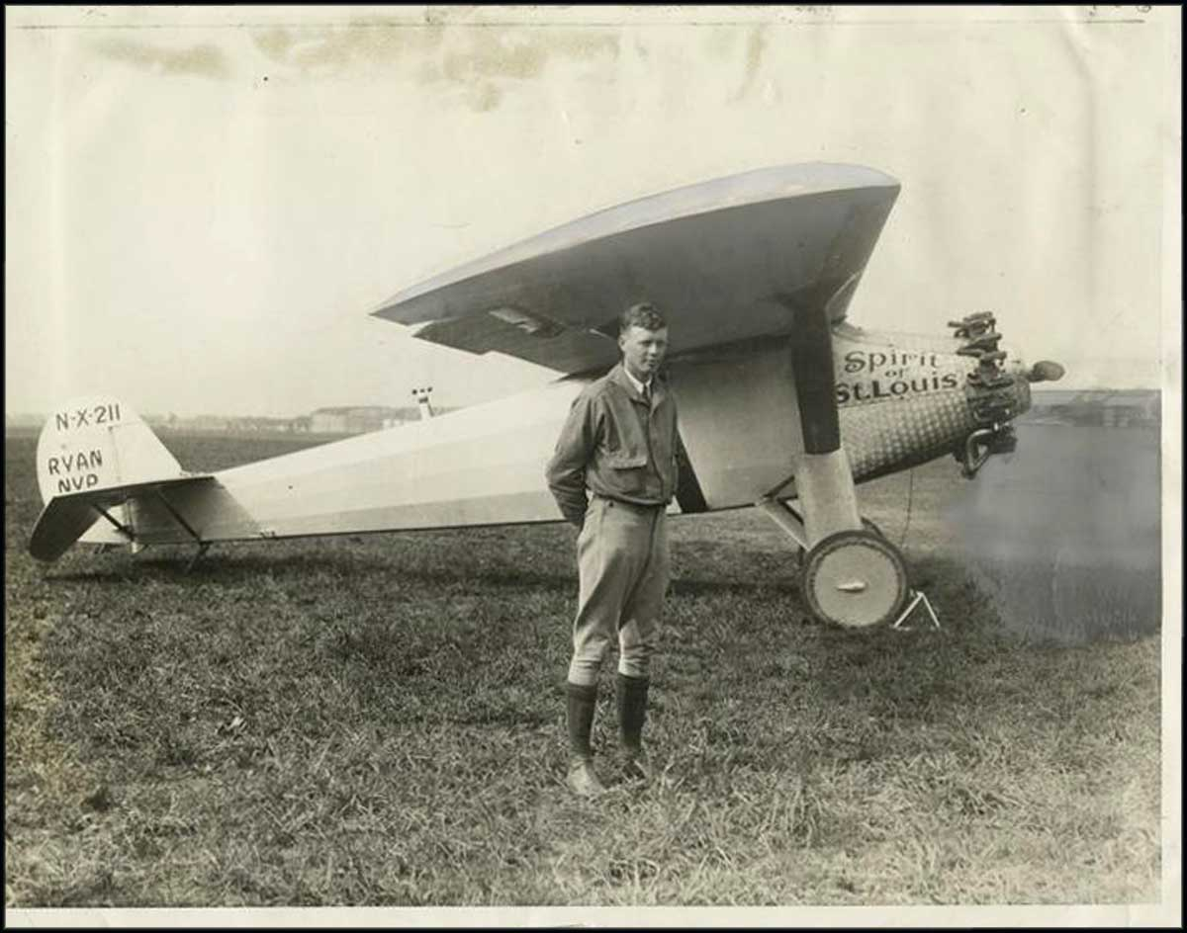
Fast, Easy Movement of People
Transatlantic travel (or across any ocean) was done by ship – about 1 week
In 1927 Charles Lindbergh succeeds in NY to Paris flight (33 hrs)
Ronald E. Giachetti
November 8, 2026
Slide <number>

Slide 22
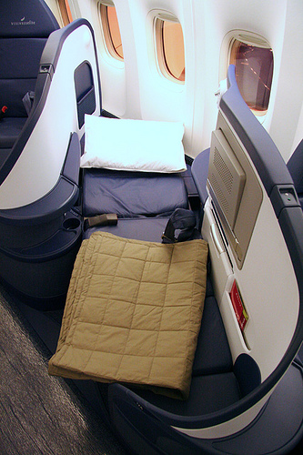

Fast, Easy Movement of People
Commercial jet air-travel started with the Boeing 707 in 1959
  Nowadays, a business traveler can go from NY to Tokyo in a day on a Boeing 777
Ronald E. Giachetti
November 8, 2026
Slide <number>

Slide 23


Cheap, ubiquitous communication
No longer are phone stuck to the wall
In third-world countries, cell phones are found everywhere
Price has decreased, features have increased
Fisherman in India using mobile
Ronald E. Giachetti
November 8, 2026
Slide <number>

Slide 24
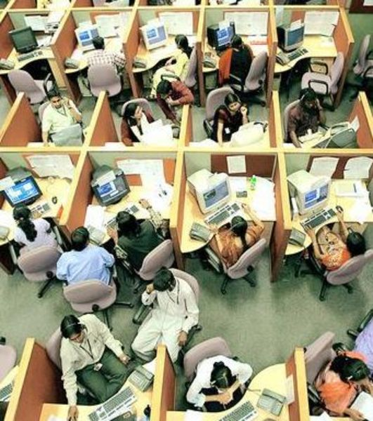
Global competition
Products compete globally
  Few trade barriers (free trade)
  Rapid, cheap, efficient logistics
Telecom & Internet have made it possible to outsource services too
  Call centers
  IT & Software development
Indian call center
Slide <number>
Ronald E. Giachetti
November 8, 2026

Slide 25
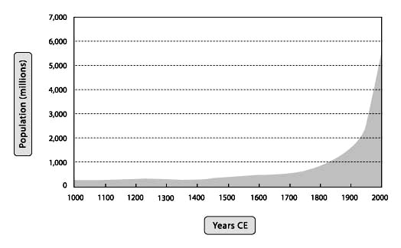
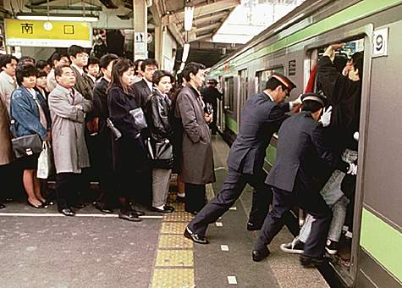
World Population
Growth has been exponential & is uneven (dropping in Europe – Growing in Africa)
In a world of limited resources there will be scarcity and higher prices
Tokyo metro
Slide <number>
Ronald E. Giachetti
November 8, 2026

Slide 26
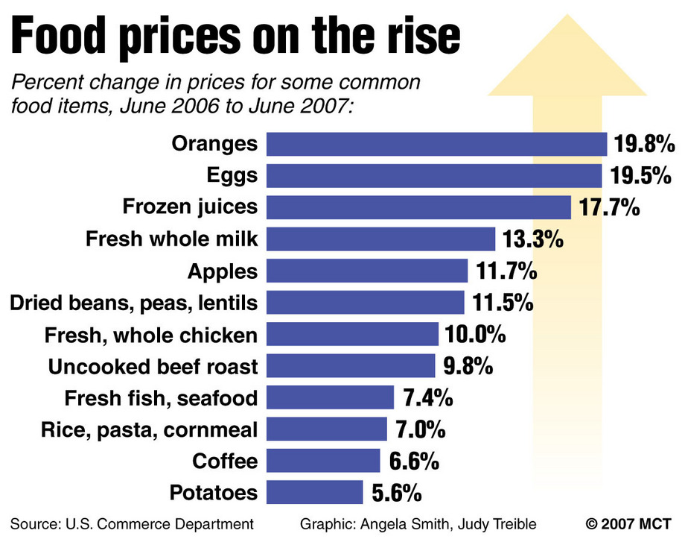
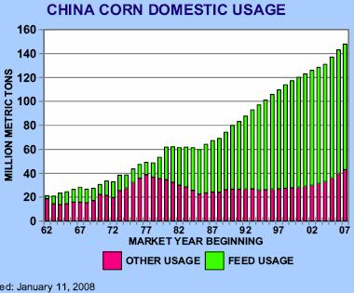
Scarce & Expensive Resources
Resources are limited (metals, land, water, fuel)
As demand increases then prices increase
Greater consumption of meat, use of biofuel exaggerate the increase demand
Ronald E. Giachetti
November 8, 2026
Slide <number>

Slide 27
Summary
The world environment is changing rapidly
Globalization is affecting all phases of life
A problem in one part of the world now affects other parts of the world
Enterprises must
  Be designed to efficiently use resources (sustainability is growth area)
  Be agile to quickly respond to environmental changes
    Monitor their environment
  Constantly improve
Ronald E. Giachetti
November 8, 2026
Slide <number>

Slide 28
History of Enterprise Engineering
Ronald E. Giachetti, Ph.D.
Associate Professor
Industrial and Systems Engineering, FIU

Slide 29
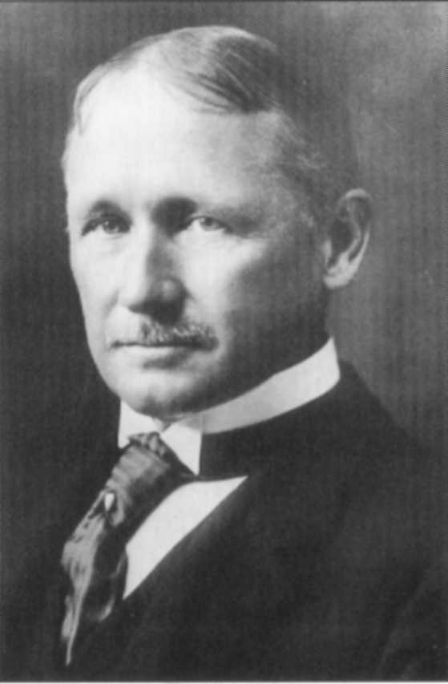
Scientific Management
Application of the scientific method to management
Primary goal efficiency of resources
The work is systematically analyzed (time studies) it is broken down into its miniscule operations, each operate is assigned to a separate worker, and an elaborate set of procedures is generated to regulate each operation
Frederick Taylor
Ronald E. Giachetti
November 8, 2026
Slide <number>

Slide 30
Scientific Management Principles
Division of labor
Time studies
Functional supervision
Standardization of tools
Standardization of work methods
Separate planning the work from doing the work
Management by exception principle
Instruction cards for workmen
Differential rate or pay for performance
A routing system
Modern costing system
Ronald E. Giachetti
November 8, 2026
Slide <number>

Slide 31
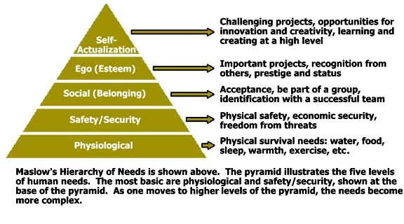
Humanist School of Management
Shifts focus from processes to the people --A reaction to Scientific Management that views man mechanistically (as a machine)
Ronald E. Giachetti
November 8, 2026
Slide <number>
Notes:
It is important to note that fulfilling the higher level of Maslow’s hierarchy of needs (Affiliation, esteem and self actualization), depends not only on the organization but on the worker’s individual qualities such as his capacity, enthusiasm and willingness to deal with personal development.

Slide 32
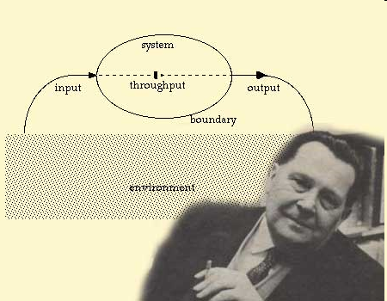
General Systems Theory
Argues that all systems share common properties
Systems must be studied holistically
You cannot break system into its constituent parts, study the parts, and then understand the behavior of the system
Bertanaffly
Ronald E. Giachetti
November 8, 2026
Slide <number>

Slide 33
Summary
Brief overview of three intellectual developments that contributed strongly to enterprise engineering.
The concepts of the human relations school did not replace the earlier scientific management school, nor has the more recent systems thinking school replaced the human relations school.
The older ideas are not abandoned by incorporated into the new ideas.
Ronald E. Giachetti
November 8, 2026
Slide <number>

